Slide 1

Abordagem Simplificada da Qualidade para SI
Material de Treinamento
Référence Chorus : 570000
Version V2.2
Notes:
Transition slide to SI part : this is the logo of SI Quality appraoch we will find in many documents.
Explain the meaning of the logo.

Slide 2

Objetivos da Formação
Você entende o que é
Abordagem Simplificada da Qualidade para SI
para você, e sua entidade.
Notes:
The objective is to present the SI quality approach, which involves everyone as an actor ; this is not a presentation of Quality organization.
Understand :
-what is Quality in SGSI,
-what is the contribution of SGSI quality approach to SGSI strategy,
-what is the contribution of SGSI quality approach to Michelin quality,
-what is your personal contribution to this approach
key vocabulary and concepts about Quality are understood or revised
the bodies which contribute to SGSI Quality approach are known / revised and classified
the way to access to institutionalized SGSI practices is known
the way to deal with a question or a problem related to Quality is known
entry points to other training materials about in-depth Quality knowledge Quality are notified

Slide 3
Agenda de Treinamento :
11 mensagens chave
Abordagem da Qualidade “Simplificada”: O que, Por que, Como?
SGSI estratégia de Qualidade
SGSI mapa de processo
SQA for SI portal
Processo de Melhoria da Governança
A organização RGQE e Qualidade
Plano de Controle Interno
Gestão de Pessoas e desenvolvimento
Medição de desempenho
Gestão de Riscos e Gestão de Crises
Sua contribuição para a "abordagem de qualidade simplificado para SI"

Slide 4
Training agenda
Abordagem da Qualidade"simplificado": O que, Por que, Como?
SGSI Estratégia de Qualidade
SGSI Processo mapa
SQA for SI portal
Processo de Melhoria de Governança
A Organização RGQE e Qualidade
Plano de Controle Interno
Gestão de PESSOAS e Desenvolvimento
Medição de desempenho
Gestão de Riscos e Gestão De Crises
Sua Contribuição par uma "Abordagem de Qualidade Simplificado for SI"

Slide 5
A Michelin desenvolve uma abordagem de qualidade simplicada
Dois níveis de ações concretas
To retain
Colocar as pessoas no coração do sistema
Suponha que no início a pessoa é competente
Conte com o profissionalismo
Confie na formação
Incentivar a iniciativa (Tudo que não é específicado)
Mudar nossos comportamentos
Pratique os MQS simplificados
Dois princípios chave
Concentre-se no essencial
Retornar para a meta do MQS
Concentre-se nos riscos prioritários
Identificar o que é fundamental, obrigatório.
Notes:
In 2005, we had an evolution of our MQS (Michelin Quality System) to better contribute to improve the performance of our company and to achieve 2 objectives :
a – our customers are satisfied of our products and services
b – our company improve continuously its performance to be competitive and to have « une longueur d’avance »
Two key principles have been defined for this new MQS
Put people at the heart of the system. Take the assumption that at the start each person is competent and integrate in the MQS all the point which will reenforce the professionalism. For that, if it’s necessary to describe processes, the most important is to train the people to their job and to processes they have to apply. An appropriate and well done training is often more important than a lot of documentation (even if documentation is also important). Encourage initiative. It’s not always necessary to describe processes in detail and could be sometimes dangerous (lost of responsibility and of initiative). People must be responsible and take initiatives to improve their day to day operations.
Focus on the essential Return on the goal of MQS : a management tool and a progress tool to help to achieve the ambitions of Michelin. Focus on the priority risks (describe first and with the appropriate level of detail the risky processes). I.e : we have described with an important level of detail some parts of P2 process because it was
important to be able to work efficiency with the convergence partners
a big change for many people in the organization (new delivery model, same processes worldwide, change of wording, ..)
At the opposite, some M1 sub processes which involve directly a little number of people in the organization has been described only at activity level. The detail of the operations was not necessary as in the P2.
Two concrete levers of action has been
Change our behaviors
With operational personnel : explain the added value of MQS for management, listen, involve, work for the user and plan their training
Audits : an approach on a positive basis and turned towards progress
Documentation : question yourself about the need, focus on the priority risks, challenge, help simplify, don’t reinvent !
Practice the simplified MQS : it means a MQS which is applied and which evolve regularly taking into account :
Group prescriptions (policies)
Business needs
Progress methods
Think simple with the just necessary
Official SGQ comments in French
Pourquoi faire évoluer notre Système Qualité ? Pour améliorer notre performance collective et aider encore davantage à atteindre ses deux objectifs : - nos Clients sont satisfaits de nos produits et services, - notre Entreprise est toujours plus performante.
Pour contribuer à atteindre cet objectif Groupe, nous avons ciblé trois enjeux d’amélioration du Système Qualité Michelin (SQM) : un système plus simple et plus accessible pour tous, mieux utilisé et intégré comme outil de management, mieux adapté aux activités non industrielles.
Comment ? - En (Re)mettant les personnes au cœur du système par : le renforcement des compétences (professionnalisation, formation), l’encouragement des initiatives (responsabilisation, implication). - En se recentrant sur l’essentiel : identifier les pratiques fondamentales communes à tous, se focaliser sur les risques prioritaires, identifier les pratiques qualité relevant de l’initiative des entités, revenir à la finalité du SQM (un outil de Management et de Progrès).
De façon concrète, nous travaillons en agissant sur 2 leviers : - Faire évoluer nos comportements : par une proximité plus forte entre les opérationnels et le réseau qualité dans les modes de travail, par une évolution des pratiques d’audits, par une approche différente de la formalisation. - Pratiquer le SQM simplifié : un SQM qui évolue en s’appuyant sur :
des éléments prescriptifs du domaine Groupe,
des éléments nécessaires au Business,
des éléments utiles pour progresser.
Un impact sur l’évolution du support documentaire :
un Manuel plus simple, élaboré à partir des Fondamentaux de la Qualité Michelin,
des processus et des documents associés (fiches processus, moins de procédures et d’instructions),
des enregistrements juste nécessaire
Translation by NA/SI
Why make evolve/move our Quality system? To improve our collective performance and to help still more to achieve its two goals: - our Customers are satisfied with our products and services, - our Company is increasingly more powerful.
To contribute to achieve this goal Groups, we targeted three stakes of improvement of the Quality system Michelin (SQM): a system simpler and more accessible for all, better used and integrated as management tool, adapted better to the non-industrial activities.
How? - In (Re) putting the people in the middle of the system by: reinforcement of competences (professionalisation, training), the encouragement of the initiatives (responsibilisation, implication). - While centering itself on essence: to identify the fundamental practices common to all, to focus itself on the priority risks, to identify the practices quality concerned with the initiative of the entities, to return to the finality of the SQM (a management tool and Progress).
In a concrete way, we work while operating 2 levers: - To make evolve/move our behaviors: by a stronger proximity enters the operational ones and the network quality the working methods, by an evolution of the practices of audits, by an approach different from formalization. - To practice the simplified SQM: a SQM which evolves/moves while resting on:
prescriptive elements of the field Groups,
elements necessary to the Business,
useful elements to progress.
An impact on the evolution of the documentary support:
a simpler Handbook, elaborate from Fundamental of Michelin Quality,
associated processes and documents (cards process, less procedures and instructions),
recordings just necessary
To implement these principles, while being true actors of the simplified Quality system, to deploy all together on the ground is a true challenge which concerns us all.
Simple and Performing MQS, It is business of all!

Slide 6


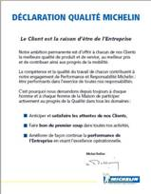
Michelin Quality Approach baseia-se na Política da Qualidade expressa através de 3 componentes
❶
PRM Carta
desempenho e
Responsabilidade
Michelin
❷
Qualidade
Afirmação
❸
Fundamentos
da qualidade
Michelin
Valores da empresa
e orientações estratégicas
Compromissos fundamentais
Da companhia
Essenciais práticas da
qualidade da empresa
Notes:
1/ 3 components
Here, a reminder that some standards basics structure the Quality Approach,
Animation :
1/ show only the title and ask who can name them ?
2/ show the 3 without legend and ask (raise hand) who knows each of these documents.
French explanation.
-La charte Performance et Responsabilité Michelin (PRM) : définit notre mission, nos responsabilités, nos valeurs (respect des clients, respect des personnes, respect des actionnaires, respect de l’environnement, respect des faits), précise nos engagements,
-les Fondamentaux de la Qualité Michelin - Pratiques Fondamentales pour : Piloter nos activités, Gérer notre personnel, Satisfaire les besoins des clients
-Déclaration qualité
La déclaration qualité Michelin a été rédigée et diffusée en 1997. La déclaration qualité rappelle nos engagements fondamentaux dans tous les sites de l'Entreprise, elle est visible par nos clients et par les organismes de certification (anticiper et satisfaire les attentes de nos Clients, faire bon du premier coup dans toutes nos activités, améliorer de façon continue la performance de l’Entreprise).
English explanation.
-Performance and Responsibility charter (PRM) : defines our mission, our responsibilities, our values (respect for customers, respect for people, respect for shareholders, respect for the environment, respect for facts), precise our commitments,
-Michelin Quality Fundamentals – fundamental practices for : steering activities, management of people, satisfaction of customers needs
-Quality statement : was written and issued in 1997 ; the Quality statement reminds our fundamental commitments in all sites of the Company, it is visible for our customers and for certification bodies (anticipating and meeting Customers expectations, achieving right first time performance in all our activities, continuously improving the performance of the Company aiming for operational excellence)
2/ MMQ
The MMQ appears : explain that this document contains the SGSI Direction team commitment (click on the picture and go into the document).
Distribute a paper copy of the MMQ, and present the different chapters.

Slide 7
Michelin política da qualidade
Disponível em SGSI mapa de processo a partir da raiz portal.
Notes:
SGSI Quality management manuel is a very important document. If there is only one document to read immediately after this presentation it’s this one.
PURPOSE AND SCOPE
This manual:
Reviews the identity of the Group: its mission, sectors in which it operates, its organization, the Group Policy and its Quality Practices.
For SGSI, it describes its mission, its organization and its different responsibilities. It specifies the applicable Quality Fundamentals as well as the measures which are applied in the framework of its Quality System.
It is applicable from January, the 1st of 2008.
The application of this Manual translates our commitment to Quality and Progress in order:
that our users be satisfied with our products and services,
to improve, with method, the performance of the Company.
The SGSI Leadership Team

Slide 8
Porque a abordagem da qualidade é um imperativo agora?
Maiores expectativas dos usuários.
Soluções de tempo para o mercado
Disponibilidade do serviço
Em todo mundo serviço de implementação do modelo de entrega.
Exigência permanente da melhoria de produtividade
BSS e IN multi-sourcing
Michelin Information Systems usados por parceiros
Crescente sofisticação dos sistemas de informação
Precisamos desenvolver funcionários SI à altura do desafio
Notes:
Why ?
To gain market part, to be more and more competitive, and more generally to achieve business ambitions, user have higher expectations
Solutions time to market
Service availability
Worldwide service delivery model implementation : we have now many project contributors located in several places in the word and we need to share the same processes and the same tools to be able to work efficiently together.
Permanent productivity improvement requirement
BSS/ICS and IN multi-sourcing
Michelin Information Systems used by customers and partners
Increased sophistication of information systems

Slide 9
Implementar SQA for SI irá contribuir para alcançar a otimização da qualidade, velocidade e produtividade.
Qualidade (No defect)
Satisfação do usuário
Eficácia operacional
Productivity
Speed
Notes:
We must have a well balanced triangle between Quality (no defect), productivity, speed in order to achieve operational effectiveness and user satisfaction.

Slide 10
Vocabulário política
da qualidade
Michelin - Política de Qualidade
PRM Carta (Desempenho e Responsabilidade)
Declaração de Qualidade
Fundamentos de qualidade Michelin
SGSI Política de Qualidade
Abordagem SQA for SI
SGSI manual de Gestão da Qualidade

Slide 11
Training agenda
Qualidade de abordagem “simplificado”: O que? Porque? Como?
SGSI Estratégia de Qualidade
SGSI Processo mapa
SQA for SI portal
Processo de Melhoria de Governança
A Organização RGQE e Qualidade
Plano de Controle Interno
Gestão de PESSOAS e Desenvolvimento
Medição de desempenho
Gestão de Riscos e Gestão De Crises
Sua Contribuição par uma "Abordagem de Qualidade Simplificado for SI"

Slide 12
“SQA for SI" é uma abordagem única de qualidade mundial que visa ajudar e alcançar as 2 ambições da nossa Estratégia de Qualidade SI
Ambição 1: A empresa Michelin está satisfeita com os produtos e serviços do SI.
Ambição 2 : Melhorar o desempenho de produtos e serviços do SI e contribuir para a melhoria do desempenho da empresa Michelin.
Notes:
Ambition 1 is a « classic » about quality, but Ambition 2 is a new quality orientation to be developed (Performance for the Company).

Slide 13

As 2 ambições da nossa Estratégia de Qualidade SI são traduzidas em 6 Objetivos

Slide 14
Ambição 1 : A empresa Michelin está satisfeito com os produtos e serviços do SI
Objetivo 1 : Os processos de Desenvolvimento, Industrialização e Produção são dominados e estão sob controle.
Objetivo 2 : Funcionários do SI têm as competências necessárias.
Objetivo 3 : O desempenho de SI e os serviços é medido a partir de um ponto de vista do cliente.
Objetivo 4 : Processo de Gerenciamento de Crise existe e é acionado quando necessário.
To retain
4 Objetivos para Ambição 1
Notes:
Very simple : we started from Michelin Quality mission letter.
The objectives are to be applied for all entities that produce something.
Goal 4 A request to have a business continuity has been addressed to all Michelin entities. Crisis management is an important part to ensure this business continuity.
Goal 1 : master : it means that all our processes must be described with the good level of detail, changes on these processes must be mastered and validated. Under control, it means we must ensure that these processes are applied and their efficiency measured.
Goal 2 : to have people who work well on the processes, we need to develop the competencies thru training, support and coaching.
Goal 3 : Our ambition is to increase the user and customer satisfaction. For that we need to measure our performance with indicators which are relevant for the user/customer.

Slide 15
Ambição 2 : Melhorar o desempenho de produtos e serviços do SI e contribuir para a melhoria do desempenho da empresa Michelin
Objetivo 5 : A Organização SI está alinhada com a Michelin e as estratégias de SI, papéis e responsabilidades são claras e conhecidas.
Objetivo 6 : Métodos de progresso são implantados e aplicados dentro de SI.
To retain
2 Objetivos para Ambição 2
Notes:
We insist on contribution to Company performance
Goal 5 : Our organization must be efficient to ensure the success of the Michelin and SI strategies. For that its important to have a clear definition of the responsibility either in the process description or for each person (post description). It’s known that people working better when they have a clear vision of their activities to perform and of their responsibilities for these activities.
Goal 6 : DPCM and all progress method (i.e benchmark, …) must be re enforce in order to improve continuously our processes.

Slide 16
Training agenda
Qualidade de Abordagem “simplificado”: O que, Porque, Como ?
SGSI Estratégia de Qualidade
SGSI Processo de Mapa
SQA for SI portal
Processo de Melhoria de Governança
A Organização RGQE e Qualidade
Plano de Controle Interno
Gestão de PESSOAS e Desenvolvimento
Medição de desempenho
Gestão de Riscos e Gestão De Crises
Sua Contribuição par uma "Abordagem de Qualidade Simplificado for SI"

Slide 17

O QMM e mapa de processo é a base de SQA
Organização, Missão, responsabilidae, mapa de processo,
procedimentos aplicáveis e SI Compromisso de Gestão
QMM
(Quality Management Manual)
Documentação para entender, executar, controlar as
atividade de SI(Modelagem de processos, materiais de treinamento
Processo de documento de execução, checklist de garantia da qualidade
Process Documentation
Rastreabilidade do trabalho realizado
Records
Notes:
For introducing process map

Slide 18
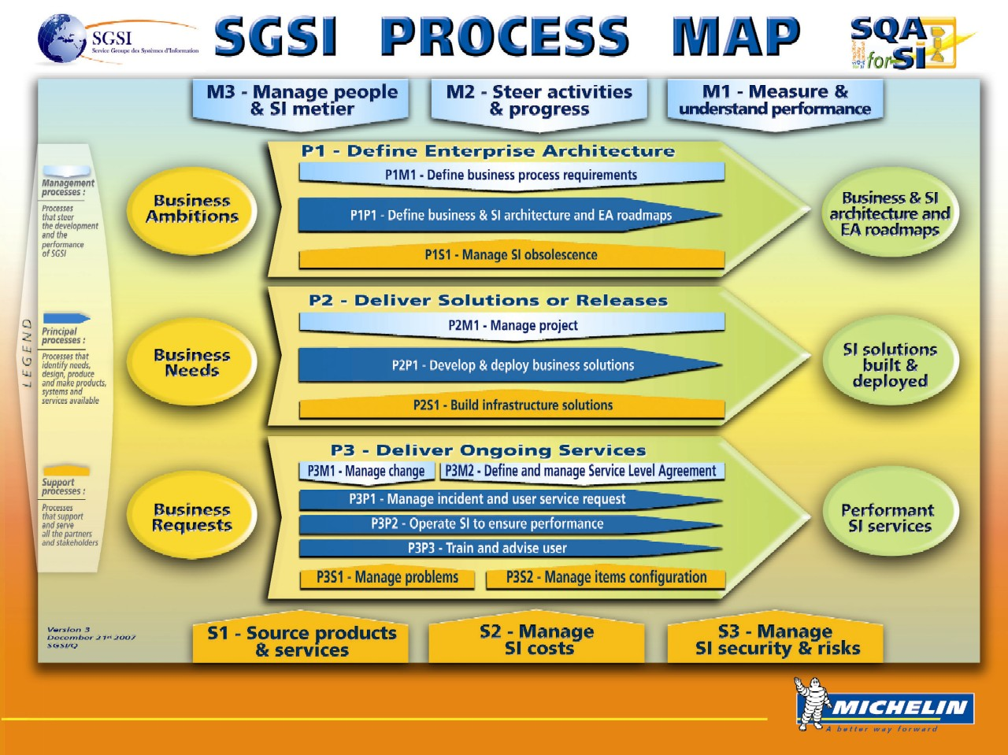
Notes:
Official comments in SQA for SI portal :
===
SGSI process map makes available practices to apply by SI people (referentials, templates, guides...) & training materials.
SGSI Processes are documented into a Process Map available to all SGSI Employees. These processes are applicable worldwide to all SGSI Entities and Departments. They are structured around Products and Services Delivery Processes centered around Business satisfaction. Delivery Processes are steered by Management Processes and supported by Support Processes.
Each Process definition is controlled by a Process Owner in charge of ensuring the process efficiency for contributing to the SGSI mission at the best cost/quality ratio. In that respect, Processes are continuously improved through a SGSI Process Improvement (PRIG).
Each process owner is responsible for implementing the controls within the processes he/she owns, while respecting Quality and Security policies.
From Michelin Group Process Map point of view, SGSI is a support Entity whose goal is to “Make available and control information systems”.
So SGSI is by nature in interface with all other Entities of the Group.
Particular emphasis can be put on the following major interfaces:
SGSI and Business Process Owners: to identify and validate Business Ambitions, Needs, Requests and deliver according services
SGSI and SGA: to ensure the most efficient sourcing of product and services
SGSI and EP mission: to guarantee protection of Information Systems services
SGSI and SGF: to manage financial resources according to Group rules
===
1/ Present the first level of processes with process owners
Explain the 3 kinds of processes
Steering Process or “directive, management or governance”. Necessary for management, for consistency and the continued improvement of all the processes.
Principal Process or “Customer Oriented or primary”. With strong impact on the business, they directly serve the customer and create added value.
Support Process : contributes to the functioning of the Principal and Steering Processes by making the necessary resources available and aiding in the control of risks.
Explain in a few words what is a process with the 4 components : Methods, People/Competencies, Material Resources, Expected performance, summarized in a process sheet ; precise the process owner responsibility
Explain that in the Michelin process map we are a support process which name is Make available and control information systems. (if necessary, we can go and see in the MMQ)

Slide 19
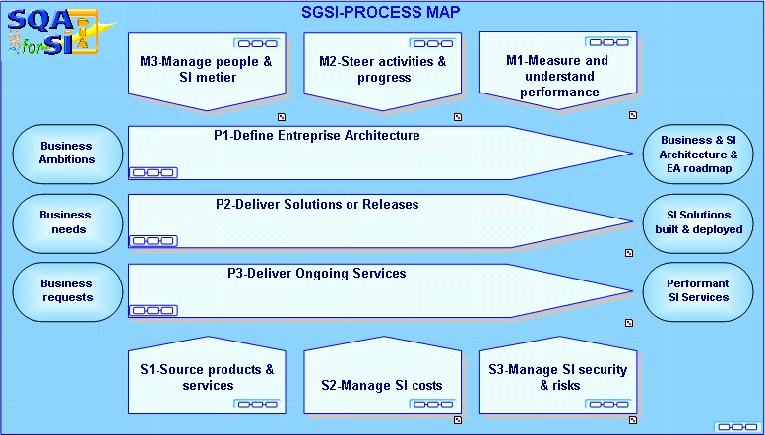
SGSI Process Map in Portal
Notes:
Show the simplification of the process map: we are focused on the essential, all principal processes go from customer to customer ...
We have reduced the number of processes (15 to 9).

Slide 20
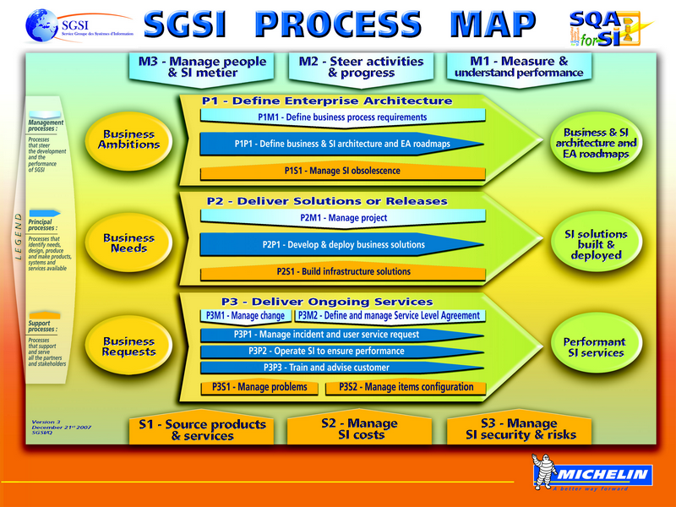
O mapa de processo SGSI é consistente com nossas práticas atuais.
Nos simplifica com a descrição dos nossos processos.
O Sistema da Qualidade é feito de acordo com o funcionamento real da entidade.
Notes:
2/ We make appear the 3 messages one by one with the following comments :
-processes formalize our practices, it is not theory
-processes are described at the just necessary level ; they must not substitute competency and common sense ; for example in some cases, a form may be sufficient
-processes are consistent with our actual functioning.
This explains why the process map has been updated.
In 2008, a more detailed training about process map is scheduled.
=> All Quality system will be derived from the process map

Slide 21
Temos atribuido Process Owners
Material Resources
People/Competencies
Processo:
Transformação
com adição de valor
Input Data
Output Data
Performance measurement
Referential
Um dono do processo é atribuído ao nível do Grupo
Sua missão é garantir o sucesso do processo e melhorar o desempenho ao longo do tempo.
Suas atividades principais são:
Definir a arquitetura do processo, identificar e implantar as melhores práticas
Definir Modelo de Processo
Definir métodos de processos e ferramentas
Garantir que os empregados SI possam compreender e aplicar o processo
Definir indicadores de desempenho e objetivos de desempenho do processo
Definir e organizar os controles dentro do processo, respeitando as políticas de Qualidade e Segurança
Definir e animar o plano de andamento do processo

Slide 22
Dono do Processo
Group CIO
SGSI
SGSI
SGSI/Q
SGSI/EA
SGSI/BSS
SGSI/IN
SGSI/SO
SGSI/F
SGSI/EP

Slide 23
Ambição 1 : A empresa Michelin está satisfeita com os produtos e serviços do SI
Objetivo 1 : Os processos de Desenvolvimento, Industrialização e Produção são dominados e sob controle
Objetivo 2 : Funcionários do SI têm as competências necessárias
Objetivo 3 : O desempenho de SI e os serviços é medido a partir de um ponto de vista do cliente
Objetivo 4 : Processo de Gerenciamento de Crise existe e é acionado quando necessário

Slide 24
Ambição 2 : SI melhora o desempenho de produtos e serviços do SI e contribui para a melhoria do desempenho da empresa Michelin
Objetivo 5 : A Organização SI está alinhada com a Michelin e as estratégias de SI, papéis e responsabilidades são claras e conhecidas
Objetivo 6 : Métodos de progresso são implantados e aplicados dentro de SI.

Slide 25
Training agenda
Qualidade de Abordagem “simplificado”: O que, Porque, Como ?
SGSI Estratégia de Qualidade
SGSI Processo de Mapa
SQA for SI portal
Processo de Melhoria de Governança
A Organização RGQE e Qualidade
Plano de Controle Interno
Gestão de PESSOAS e Desenvolvimento
Medição de desempenho
Gestão de Riscos e Gestão De Crises
Sua Contribuição par uma "Abordagem de Qualidade Simplificado for SI"

Slide 26
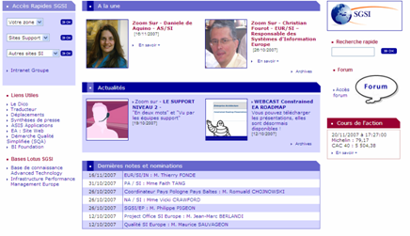
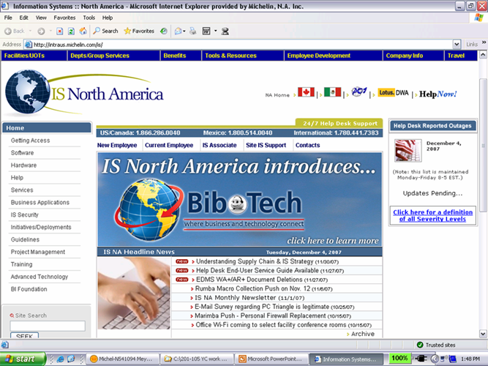
«SQA for SI» portal
Access from
SGSI intranet :
“Simplified
Quality
Approach
(SQA)”
Example for EUROPE
Example for North America
Or keep in mind the link :
http://sqa.michelin.com
Notes:
Europe version

Slide 27

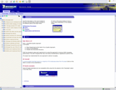

Informação essencial é facilmente disponível
Modeling processes
MEGA
Único em todo o mundo.
Who ?
What ?
When ?
Process Owner
Portal
generation
Loja de Registros
(REPOSITORY)
SI users
Alcançar a documentação do processo
(“SQA for SI” Portal)
Notes:
We are worldwide : so one unique referential accessible everywhere (before : one quality database by zone), named SQA for SI Portal (Explain : SQA = simplified quality approach make the link with the logo)
Explain the structure :
1. processes described in MEGA
2. related documentation is in a repository and a link with process is done
3. one portal in frontal access is provided based on MEGA and REPOSITORY for documentation
The portal help to have a process vision.

Slide 28
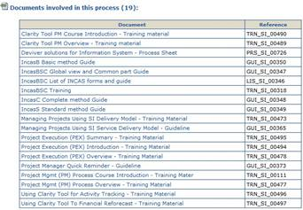
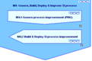
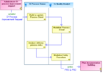
Os documentos necessários estão ligados ao mapa do processo e as atividades
Process
Modeling
Process
Execution
Documents
Folha de
Processo
Training
material
Quality
Assurance
checklist
A Formação das pessoas
Através de um Plano
de Implantação
Access from intranet SQAforSI
Notes:
Come back on simplification principle : :
-we formalize only what is necessary (in some cases, a form and a first level of description in MEGA are sufficient)
-but, we ensure training and feedback (quality assurance checklist) exist ;
-documentation has been simplified (less head pages and annexes, a better look => show an example)
-process owners are the one who define their needs, not the quality

Slide 29
Ambição 1 : A empresa Michelin está satisfeita com os produtos e serviços do SI
Objetivo 1 : Os processos de Desenvolvimento, Industrialização e Produção são dominados e estão sob controle
Objetivo 2 : Funcionários do SI têm as competências necessárias
Objetivo 3 : O Desempenho de SI e os serviços é medido a partir de um ponto de vista do cliente.
Objetivo 4 : Processo de Gerenciamento de crise existe e é acionado quando necessário

Slide 30
Training agenda
Qualidade de Abordagem “simplificado”: O que, Porque, Como ?
SGSI Estratégia de Qualidade
SGSI Processo de Mapa
SQA for SI portal
Processo de Melhoria de Governança
A Organização RGQE e Qualidade
Plano de Controle Interno
Gestão de PESSOAS e Desenvolvimento
Medição de desempenho
Gestão de Riscos e Gestão De Crises
Sua Contribuição par uma "Abordagem de Qualidade Simplificado for SI"

Slide 31
Assegurar a coerência em todo o mundo na descrição de processos e implantação
Governança Controlar os processos de evolução, os impactos e a coerência global do mapa de processo SGSI
PECB Problem report and Enhancement request Control Board = Relatório de problema e de Valorização, Conselho de Controle de solicitação para cada processo sob a responsabilidade do proprietário do processo.
PRIG Process Improvement Governance = Processo de Melhoria de Governança , com uma comissão ao nível do Grupo.
Methodology para eficiência de construção e desenvolvimento de um processo
Regras de modelagem e documentação alinhado com a prescrição SGQ, de acordo com uma abordagem simplificada de Regras de implantação definidas para uma abordagem mundial
Notes:
Processes are updated in an organized and worldwide manner.
2 axis :
-governance - 2 steps : process (PECB), and Process Map (PRIG), in the 2 cases at Group level only,
-methodology for formalizing and deploying a process, in which we take in account simplification / just necessary orientation (which conducts to the ‘flower’ seen previously)
NB. a more detailed training on PECB / PRIG will be available in 2008

Slide 32
Assegurar a coerência em todo o mundo na descrição de processos e implantação
Para tratar com sucesso o desafio de definir processos consistentes em todo o mundo
PRIG Committee
Leadership Team SGSI
PECB
Process owner
One PECB by process at Group Level
definimos estes orgãos de governança
Notes:
PRIG / PECB
The different levels of validation
There are 2 ways for evolution
-bottom – up : spontaneous requests, local quality control or performance results (entity level)
-top – down : provided by SGSI progress plan
-in mode bottom – up, entry point is RGQE
In both cases, deployment is ensured by the process owner
-a each step, there is a filter (not all requests are escalated to PRIG or EDI (Leadership team))
Ex. an understanding question is answered at RGQE level, a request about a form is managed at PECB level ; for the PRIG : only major evolution of a process, or what impact many processes, or priority problems ; at EDI level, we validate what impacts the process map, or the deployment of a new process.
Each PECB is in charge of analyzing and prioritizing requests.
SGSI/Q is the first level of PRIG, checks consistency of the request and gives orientation to the PECB on how to answer to the request ; for an action coming from the progress plan, SGSI/Q verifies that it is taken in account by the concerned PECB.
The list LIS SI 01101 available in SQAforSi portal identifies SI process owners, PRIG committee members and PECB process leaders & members.
(to find it ; Go to SGSI process map level and click on « business process »)

Slide 33
PRIG Participants
SGSI/QPO Leader
SGSI/QPO Coordinator
PECB Leaders
Quality Zone Representatives
SQA for SI Team (optional)
Process Owners : (optional)

Slide 34
Assegurar a coerência em todo o mundo na descrição de processos e implantação
Regras de implantação
Produzir um plano de implantação
Comunique-se com gestão SI e rede de qualidade a decisão Governança pendente.
Aplicar o plano de implantação
Notes:
We want to avoid the “classics” (publish and push by mail)
Communication about major evolutions is performed via a « SGSI Decision Communication Letter »

Slide 35
Garantirmos uma gestão e acompanhamento de melhorias de processo sob o controle do Governo
Os pedidos de melhoria são geridos e controlados dentro da ferramenta JIRA.
Líder PECB é responsável pelo ambiente JIRA do seu processo
Cada processo tem seu próprio ambiente para gerenciar solicitações de seu aperfeiçoamento.
As solicitações são analisadas pelo responsável, que aprova ou rejeita e atribui uma prioridade.

Slide 36
Ambição 1 : A empresa Michelin está satisfeito com os produtos e serviços do SI
Objetivo 1 : Os processos de Desenvolvimento, Industrialização e Produção são dominados e sob controle
Objetivo 2 : Funcionários do Si tem as competencias necessárias.
Objetivo 3 : O desempenho de SI e os serviços é medido a partir de um ponto de vista do cliente
Objetivo 4 : Processo de Gerenciamento de Crise existe e é acionado quando necessário.
Notes:
Contribution de la gouvernance des processus au goal 1

Slide 37
Ambição 2 :O SI melhora o desempenho de produtos e os serviços do SI e contribui para a melhoria do desempenho da empresa Michelin
Objetivo 5 : A Organização SI está alinhada com a Michelin e as estratégias de SI, papéis e responsabilidades são claras e conhecidas
Objetivo 6 : Métodos de progresso são implantados e aplicados dentro do SI.

Slide 38
Vocabulário chave Processo de Melhoria de Governança
PECB - Problem report and Enhancement request Control Board
PRIG Committee - Process Improvement Governance
LST SGSI (Leadership Team SGSI)
JIRA Process change management tool

Slide 39
Training agenda
Qualidade de Abordagem “simplificado”: O que, Porque, Como ?
SGSI Estratégia de Qualidade
SGSI Processo de Mapa
SQA for SI portal
Processo de Melhoria de Governança
A Organização RGQE e Qualidade
Plano de Controle Interno
Gestão de PESSOAS e Desenvolvimento
Medição de desempenho
Gestão de Riscos e Gestão De Crises
Sua Contribuição par uma "Abordagem de Qualidade Simplificado for SI"

Slide 40

O compromisso da Equipe de Liderança do SGSI para a Qualidade e Progresso é demonstrado por uma organização de qualidade dedicada e representando requisitos e expectativas dos usuários de melhoria de desempenho

Slide 41
Para cada entidade, uma entidade de gestão da qualidade é responsável representando o nome.
RGQE = “Para CADA Entidade, Uma Entidade de Gestão da Qualidade Responsável representando o nome”
RGQE garante que o Sistema da Qualidade é implementada por todos os funcionários da entidade. Como membro da equipa de gestão da entidade, RGQE é responsável por garantir a qualidade dos produtos e serviços entregues aos usuários Como último recurso, o RGQE tem autoridade para suspender o envio de qualquer produto ou serviço da entidade quando a sua qualidade irá apresentar um risco inaceitável para o cliente ou a empresa.
Notes:
RGQE assures that the Quality System is implemented by all employees of the entity. His/her mission is to implement and run the quality system within its entity in coherence with SGSI/Q orientations.
In link with managers, he/she has to ensure that the people are the required competencies to do their job.
He/she has to train the people to the SQA for SI and to ensure the level 1 of support for all the processes of SI process map.
As a member of the management team of the entity, RGQE is responsible for guaranteeing the quality of products and services delivered to users. The RGQE draw-up and follow-up the Internal Control Plan (ICP) for its entity. By performing the controls, he guarantee the quality of the products and services delivered by its entity. This guarantee must be product oriented. The level of guarantee depends on the level of risk on the product or on the service.
As a last resort, the RGQE has the authority to suspend the deployment of any product or service of the entity when its quality would present an unacceptable risk for the customer or the company. All the RGQ in the Michelin company have this responsability. If during a control and based on facts the RGQE identifies a risk on the product or service he has to take all the appropriate actions with the management support.

Slide 42
Atividades RGQE
RGQE - Análises do desempenho da entidade
RGQE - Assegura a execução do Plano de Controle Interno da entidade
RGQE - facilitar a implantação e suporte dos processos dentro da entidade
Notes:
Explain that this is the RGQE who makes the link between the entity and PECBs

Slide 43
RGQE dentro da organização
RGQE = “Responsável pela garantia de qualidade dentro de uma entidade”
…
SGSI/Q
…
SGSI/Q
AC/SI/Q
PA/SI/Q
NA/SI/Q
NA/SI/Q
Zone/SI/Q
Zone/SI/Q
ex: EUR/SI/Q
…
…
…
…
Entité 2
Entity 2
Entité 1
Entity 1
RGQE
RGQE
Organização de Qualidade dentro do SGSI
Quality Organization within SGSI
Notes:
Explain that the responsibility of a Q zone Manager is on all the territory (Zone + Group entity located in the zone)

Slide 44
Agenda de Treinamento
Qualidade de Abordagem “simplificado”: O que, Porque, Como ?
SGSI Estratégia de Qualidade
SGSI Processo de Mapa
SQA for SI portal
Processo de Melhoria de Governança
A Organização RGQE e Qualidade
Plano de Controle Interno
Gestão de PESSOAS e Desenvolvimento
Medição de desempenho
Gestão de Riscos e Gestão De Crises
Sua Contribuição par uma "Abordagem de Qualidade Simplificado for SI"

Slide 45

O controle de qualidade é baseado em um Plano de Controle Interno
O controle de qualidade é baseado em um Plano de Controle Interno (ICP) que definiu a nível da Zona Group, e Entidade
=> Verificar o que foi feito nos permite tomar ações para conduzir a melhoria contínua.
Notes:
Quality control becomes a recurrent activity, annually planed for all levels of the organization.
The word « control » must be understood in the sense of manage, master, not only check.
There is the conformity of product and the conformity of processes.
Here, we are focused mainly on processes, and intermediate products of processes;
Remind the objective (in red) : it is for progress.

Slide 46
Colocando em prática controles de qualidade
Referential
Processos descritos em SQA for SI portal
Requirements
Implementation
❒
Controle de Qualidade
(QA checklist)
Practice
Práticas reais e os serviços executados pelas equipes do SI
Notes:
Remind : processes described in the portal represent the institutionalization of practices, not a faraway target
1st level of control : are internal practices in conformity with SI referentials ?
The rhythm of the controls depend on the process :
-ex: by project, periodic, ...
May be auto-control.

Slide 47
Colocamos avaliações
Referential
Requisitos em Processos
Requirements
❒
Implementation
Avaliação por SGSI
controlador interno
Practice
Práticas reais e os serviços executados pelas equipes do SI
Notes:
2nd level of control : are our practices compliant with the ones of an efficient organization (% a benchmark) ?
Is performed in light mode (1/2 day interview) , once a year for all entities.

Slide 48
As 3 camadas de SGSI de Controle Interno (SGSI Quality Assurance)
Avaliação interna
Avaliação
Internal Control
Plan
Parceiros de Auditoria
Controle interno de SGSI
QA check-lists controls
Projetos
Garantir
Não projeto
Análises por pares, teste de backup(PE2c), …
Tests, IMAC check-list, …
RGQE, QA Lead
Contra-Verificação
Verificação
Entity Quality
Plan
Verificação
As equipes de Projeto e Infra
Notes:
SGSI Internal Control is SGSI Quality Assurance.
SGSI Internal Control Plan matches our SGSI Quality Assurance Plan.
It comprises 3 layers:
The verification – from Project and Infra teams who verify the quality of what they produce. All starts from here.
The guarantee – from RGQEs who control and must master the leakage rate of defects and guarantee to entity managers the quality of what is produced in the Entity
The SGSI Quality/Security internal audit – which ensures to SGSI Management Team the good control of our risks thanks to the right global execution of what precedes.
Thus the Internal Control comprises the 3 layers together (global control) and the internal controls correspond to the actions that precede, and can therefore be of 3 different types (verifications, controls, audits).

Slide 49
O ICP é dirigido por planos de abordagem e sua organização é baseada em práticas internas industriais organizados da mesma maneira
ICP
Tipo de Controle
Control Plan
to execute
Quality check list
to pass
Pode referir
Internal Appraisals
Referir para
Project Controls
Non project controls
Partner audit
Indicators
Management meetings
Quality meetings
Monitoring and control
Notes:
Internal Quality Audits
Based on requirements on processes, verify if the practices and our process descriptions are compliant and capture the ways of improvement.
Project Controls (P2 : Deliver solutions or releases)
Based on our SQA referential and on the project management plan, verify the compliance, capture and treat the Non Conformities.
Non Project Controls (P2 excluded)
Based on our SQA referential and on the Quality plan of the entity verify the compliance, capture and treat the Non Conformities.
Partners Quality audits
Appropriate visibility on selected intermediate products developed by the partner
Appropriate visibility on selected processes (processes that are critical for SI)

Slide 50
Os resultados de qualidade, incluindo não-conformidades, estão geridos
Ao realizar atividades de garantia de qualidade, estamos acompanhando não-conformidades, a fim de eliminar a causa do mesmo
A não-conformidade é um fracasso para cumprir um requisito específico de um produto ou serviço; por extensão, não-conformidade pode aplicar a um processo
Não-conformidades devem ser registradas (JIRA), classificadas e resolvidas.
To retain
Notes:
NC on projects (reference = project commitments : cost, time, scope)
> Cost (on budget X1 X2 X3)
> Time (on time X1 X2 X3)
> Customer satisfaction
> Contractor (smiley Infra (IBM))
> On scope X3
> Smiley Synthesis
NC on delivery (reference = all SGSI commitments for customer)
> availability, outage, response time, batch, transit time, lost message
bugs, Applicative Support performance, Continuity performance,
Infrastructure Support performance (help desk) , PC delivery)
NC on Processes (reference = process validated and in the portal)
(origin : QA check list which result is not ok)
NC contractor (reference : all contractor commitments for SGSI)
NC client (all client dissatisfaction)
> claim
All the Non-conformities are managed with JIRA.
JIRA is used also to manage:
PR/ER (problem and Enhancement Requests) in projects and for process improvement.
complaints
IN issues
SGB recommendations after Audit
Problem report in test
Problem report in production (MASC level)
Actions
…

Slide 51
Ambição 1 :A Michelin está satisfeita com os produtos e serviços do SI
Objetivo 1 : Os processos de Desenvolvimento, Industrialização e Produção são dominados e sob controle
Objetivo 2 : Funcionários do SI têm as competências necessárias
Objetivo 3 : O desempenho de SI e os serviços é medido a partir de um ponto de vista do cliente
Objetivo 4 : Processo de Gerenciamento de Crise existe e é acionado quando necessário
Notes:
AQ address all goals, as we ensure the deployment of all the approach

Slide 52
Ambição 2 : SI melhora o desempenho de produtos e serviços do SI e contribui para a melhoria do desempenho da empresa Michelin
Objetivos 5 : A Organização SI está alinhado com a Michelin e as estratégias de SI, papéis e responsabilidades são claras e conhecidas
Objetivos 6 : Métodos de progresso são implantados e aplicados dentro de SI
Notes:
AQ address all goals, as we ensure the deployment of all the approach

Slide 53
Vocabulário chave Plano de Garantia de Qualidade Anual
Verificação
Controles de qualidade (QA lista de verificação)
Avaliações
Não-conformidade

Slide 54
Training agenda
Qualidade de Abordagem “simplificado”: O que, Porque, Como ?
SGSI Estratégia de Qualidade
SGSI Processo de Mapa
SQA for SI portal
Processo de Melhoria de Governança
A Organização RGQE e Qualidade
Plano de Controle Interno
Gestão de PESSOAS e Desenvolvimento
Medição de desempenho
Gestão de Riscos e Gestão De Crises
Sua Contribuição par uma "Abordagem de Qualidade Simplificado for SI"

Slide 55
A Competência é uma capacidade demonstrada para aplicar conhecimentos, habilidades e atitudes para alcançar resultados observáveis
Funcionários do SI têm as competências necessárias
Eles incluem...
Comportamento (Ex: Building relationships / teamwork)
Habilidades
(Ex: Applying tools and procedures of SGSI Project Management Methodology)
Conhecimento
(Ex: Managing projects)
Temos de nos concentrar nas competências que realmente fazem a diferença
Notes:
Introduction : Competencies = not only technical
3 levels
The more we go to « Personal Attributes », the more it is difficult to improve
Translation in French :
Competency Compétence
Knowledge Connaissance
Skill Savoir-faire
Attitude Comportement, Savoir être

Slide 56
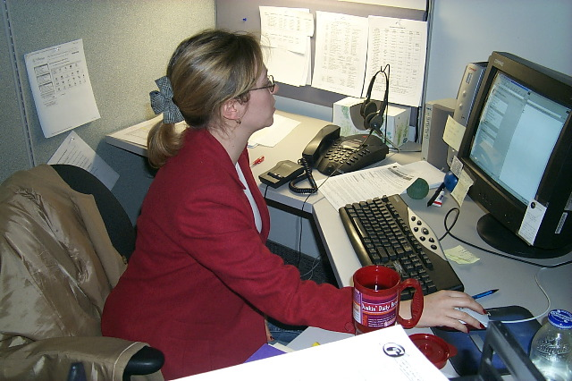

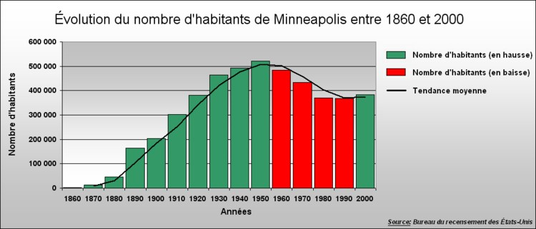




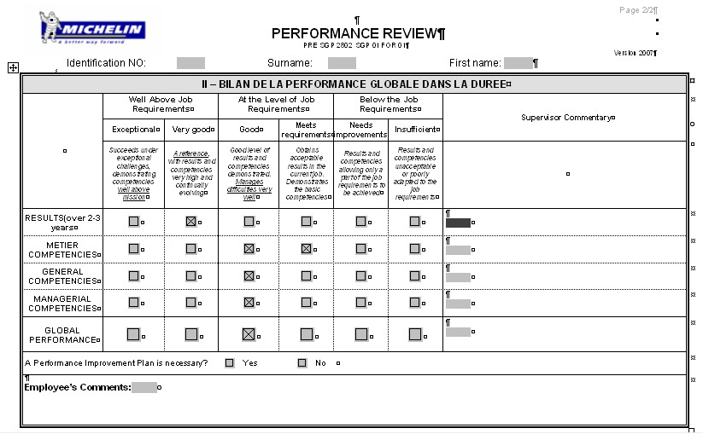



Funcionários do SI têm as competências necessárias
2. Atribuição empregado
Exigência pessoal definição
3. Gestão de pessoas e desenvolvimento
To retain
Notes:
Comment : nothing really new, but we must apply !
We may explain that we have a SI métier referential :
14 competencies, added to the standard Michelin competencies (9 general and 4 managerial) : 6 métiers, 6 business, 2 complementary
1 Existing information systems and technologies
2 Solution design and development
3 Components and packages integration
4 Application and definition of methods, tools, and procedures
5 Architecture design
6 Emerging technologies
7 Business strategy and processes
8 Business change management
9 Project management
10 Risk management
11 Commercial approach
12 Supplier management
Language (French and English)
Negotiation and Facilitation
And about 40 jobs grouped in 8 families
Architecture
Business
Development and Integration
Infrastructure
Internal Support
Management
Project Management
User Support

Slide 57

Funcionários do SI têm as competências necessárias
Personnel requirement definition
Forecast needs
Reference documents
1
Define the position
Levels of
Competency
Required for
The position
Position
description
(generic)
2
Request personnel to SP
Personnel
request
Notes:
NB. By clicking on the picture, you go to REF 40 document if necessary to show the documents

Slide 58

Funcionários do SI têm as competências necessárias
Position
description
(assigned)
1
Assign the applicant
Employee
competency
assessment
2
Assess competencies
Individual
Training
Program
3
Define ITP
4
Execute ITP
Individual
Training
Requests
5
Qualify the employee to his/her position
Position
description
(qualified)
ITP : Individual Training Program
Funcionários SI são qualificados para posições
Notes:
Insist on Qualification
Animation : ask to the trainees : who has a post description ?
Give the example of a plant, people who are making tires ; our métier is complex too.
Objective of the qualification :
Formalize that the employee possesses all the characteristics listed in his/her position description in order to ensure the minimum expected performance
Confirm the mission statement, activities and responsibilities listed in the position description
Formalize the end of the period of adaptation to the position and the beginning of the period where support conditions to control risks must be applied
The line manager ensures that the employee:
Possesses the prerequisites
Has completed the ITP and acquired competencies
Has achieved the minimum performance threshold for the position
The line manager is able to provide auditors with elements to justify the qualification
NB. By clicking on the picture, you go to REF 40 document if necessary to show the documents

Slide 59
Funcionários do SI têm as competências necessárias
1
Define Annual Performance Objectives and Personal Development objectives
APR (N+1)
Annual cycle
2
Perform the Annual Performance Review
APR (N)
3
Execute personal development objectives
Individual
Training
Requests
4
Perform recognition actions
Request of
Recognition
actions
APR :Avaliação de desempenho Anual PDR :Revisão Periódica de desenvolvimento
5
Perform the Periodic Development Review (every two years)
PDR
Notes:
Insist on periodic development reviews
NB. By clicking on the picture, you go to REF 40 document if necessary to show the documents

Slide 60
Chorus - É a referência para todos os dados dos funcionários SI relacionados
2. Atribuição ao
funcionário
Definição da exigência
pessoal
3. Gestão de pessoas e desenvolvimento
CHORUS
Notes:
CHORUS is the standard system

Slide 61
Ambição 1 : A empresa Michelin está satisfeita com os produtos e serviços do SI
Objetivo 1 : Os processos de desenvolvimento, industrialização e produção são dominados e sob controle
Objetivo 2 : Funcionários do SI têm as competências necessárias
Objetivo 3 : O desempenho de SI e os serviços é medido a partir de um ponto de vista do cliente
Objetivo 4 :Processo de gerenciamento de crise existe e é acionado quando necessário

Slide 62
Ambição 2 : SI melhora o desempenho de produtos e serviços do SI e contribui para a melhoria do desempenho da empresa Michelin
Objetivo 5 : A Organização SI está alinhada com a Michelin e as estratégias de SI, papéis e responsabilidades são claras e conhecidas
Objetivo 6 : Métodos de progresso são implantados e aplicados dentro de SI

Slide 63
Key Vocabulary
People Management & Development
Competência
Descrição do cargo
APR (Avaliação de desempenho anual)
PDR (Revisão Periódica de Desenvolvimento
ITP/PIF (Programa de Formação Individual)
Qualificação
Group procedure PRG347 “Manage & develop people” available in SQA for SI portal

Slide 64
Training agenda
Qualidade de Abordagem “simplificado”: O que, Porque, Como ?
SGSI Estratégia de Qualidade
SGSI Processo de Mapa
SQA for SI portal
Processo de Melhoria de Governança
A Organização RGQE e Qualidade
Plano de Controle Interno
Gestão de PESSOAS e Desenvolvimento
Medição de Desempenho
Gestão de Riscos e Gestão De Crises
Sua Contribuição par uma "Abordagem de Qualidade Simplificado for SI"

Slide 65

O desempenho de SI e os serviços é medido a partir de um ponto de vista do usuário.

Slide 66

Report performance dashboard
Produzir painéis de desempenho em diferentes níveis de organização (Entidade SGSI, zona, grupo) para seguir o plano de atividades SGSI. .
Produce performance results
Organization oriented
Process oriented
Analyze performance results
Report performance dashboard
TDB des priorités
PRC
BSC
Monitor and improve activities performance
CRAM
PSR
Notes:
We have 2 axes for performance:
One is organization oriented with at the top the priority dashboard which is provided by all the MICHELIN entities. This dashboard is for the CEG. The BSC : Balanced Score Card is to pilot SGSI. PSR : Performance Status Report is the BSC of all entities within SGSI. It’s a drill down at entity level of part of BSC Key Process Indicators (KPIs) with in addition KOIs (Key Operationnal Indicators).
It is important to distinguish between
results indicators which concern criteria perceptible by the customer (KPI: Key Performance Indicator)
and process indicators (KOI : Key Operational Indicator) which concern criteria internal to the process (including resources) and the purpose of which is to control the activities of the process.
Another is process oriented with 2 main reviews:
PRC for the P2 process performance (Deliver solutions or releases)
PERF for the P3 process performance(Deliver ongoing services)

Slide 67
O Balanced Scorecard é utilizado para medir o desempenho SI
O objetivo do BSC é medir facil e rapidamente o progresso de nossa estratégia de SI e experiência dos nossos usuários
A medida do desempenho de SI é levada de uma maneira que equilibra todos os domínios da estratégia de SI e processo
Balanced
Scorecard

Slide 68

BSC coloca o foco sobre críticas KPIs pouco identificando os 4 seguintes tipos
Todos os KPIs são comparados com uma figura de referência
Notes:
We have different types of KPis.

Slide 69
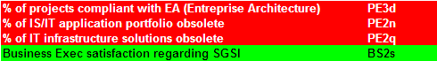
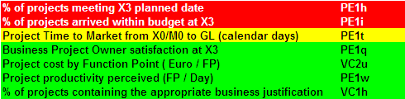
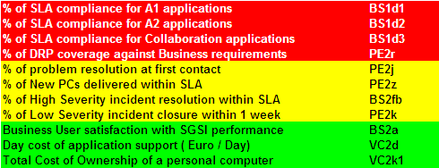
Performance Indicators
(PO : CIO)
P1-Define
Entreprise
Architecture (SPO : EA)
Business & SI Architecture +
EA roadmaps
Business Ambitions
P2 -Deliver
Solutions
or releases
(SPO : BSS)
SI solutions built & deployed
Business Needs
P3 -Deliver
Ongoing
Services
(SPO : IN)
Performant SI
services
Business Requests
(PO : process owner SPO : sub process owner)
69
Notes:
The KPIs differ depending on the nature of the organization and the organization's strategy. They help an organization to measure progress towards their organizational goals, especially toward difficult to quantify knowledge-based processes.
A KPI is a key part of a measurable objective, which is made up of a direction, KPI, benchmark, target and time frame. For example: "Increase Average Revenue per Customer from £10 to £15 by EOY 2008". In this case, 'Average Revenue Per Customer' is the KPI.
We have chosen KPIs which seems the most representative for the user / customer in term of results.
These KPIs are reviewed every year in term of target, threshold, ceiling. Every year (November) during the Plan approach, we verify id the KPIs is always relevant and if we need other KPIs.

Slide 70
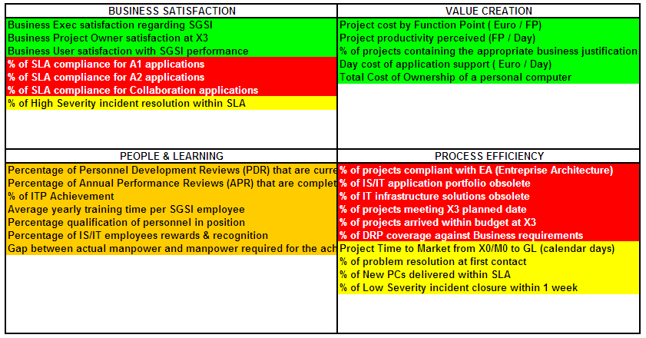
Performance Indicators
BUSINESS SATISFACTION
VALUE CREATION
PEOPLE & LEARNING
PROCESS EFFICIENCY
Notes:
The Balanced ScoreCard (BSC) is a strategic planning and management system used to:
align business activities to the vision and strategy of the organization
improve internal and external communications
monitor organizational performance against strategic goals
The Balanced ScoreCard is a strategy management and monitoring tool developed in the 1990’s by Dr Kaplan & Norton, of Harvard University.
The objectives and measures of the BSC are derived from an organization’s vision and strategy.
They view organizational performance from 4 perspectives :
Financial (Value Creation)
Customer (Business Satisfaction)
internal business process (Process efficiency)
learning and growth (People and learning)
These perspectives provide the framework for the Balanced ScoreCard

Slide 71
The performance is monitored monthly at all levels
Project Office
BSS
IN
EP, Q, ...
F
Projects
dashboard
BSS SLA
results
PSR
(Performance
Status
Report)
VISO
Status
(if app.)
IN SLA
results
Other
Specific
Reports
Budget
Status
MPM
BSC
Projects review Committee
Zone CRAM
(Compte-Rendu
d’Activité Mensuel)
Actions Plans
Root Cause Analysis tracking
Non-Conformities tracking
Performance review Committee
Notes:
Insist on the fact that performance is managed at all levels of the organization (entity, territory, Group) and for all functions (BSS/ICS, IN, ...), so all actors contribute to client satisfaction.
Explain the SLA approach et the meaning of SLA ‘Service Level Agreement)
We want a customer oriented view ; 2 axis to be considered :
- External view : application view disappears, replaced by a service view based on business processes ; for this, we use EA works ;
-Internal view : service commitment must be global, taking in account all contributors (PF, MASC, Centres de services, Infra) ; the PF carries the commitment and manages it.
Then the measure must correspond to this commitment ; finally, the orientation is to get the measure the more ‘real time’ possible.
Currently, SLAs are mainly by application, et the measure by tickets analysis.
In Actions plan, there are corrective and preventive actions (we act on the cause and on the impact).

Slide 72
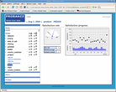

Nós melhoramos nosso conhecimento dos guias de satisfação, e os usuários do grupo
Gestão da Satisfação Medição da satisfação por grupo de usuários As indicações de mudança significativa de satisfação Motoristas de satisfação por grupo de usuários plano de Ação
Análises Periódicas
Vistoria online
periódica
Notes:
Whatever we say or think, the customer has a final judgment.
For quality, it is a necessary indicator to check the global consistency of the approach.
We can explain here the different levels of customers : strategic, tactic, end-users, with different expectations.
Today, we have surveys in projects, an annual satisfaction survey (to become more frequent and more pro-active), IBM helpdesk survey, and in some zone monthly surveys in country
In 2008, we want to launch an approach to have more frequent surveys, more accurate and more targeted.

Slide 73
Ambição 1 : A empresa Michelin está satisfeita com os produtos e serviços do SI
Objetivo 1 : Os processos de Desenvolvimento, Industrialização e Produção são dominados e sob controle
Objetivo 2 : Funcionários do SI têm as competências necessárias
Objetivo 3 : O desempenho de SI e os serviços é medido a partir de um ponto de vista do cliente
Objetivo 4 : Processo de Gerenciamento de Crise existe e é acionado quando necessário

Slide 74
Ambição 2 : SI melhora o desempenho de produtos e serviços do SI e contribui para a melhoria do desempenho da empresa Michelin
Objetivos 5 :A organização SI está alinhada com a Michelin e as estratégias de SI, papéis e responsabilidades são claras e conhecidas
Objetivos 6 : Métodos de progresso são implantados e aplicados dentro de SI
Notes:
Contribution to goal 6 (we use standard progress tools for tracking results (RCA, ...)).

Slide 75
Key Vocabulary
Performance Measurement
BSC - Balanced Scorecard
KPI - Key Performance Indicator
KGI - Key Goal Indicator
SLA - Service Level Agreement
PSR - Performance Status Report
Projects Review Committee
PRC - Performance Review Committee
RCA - Root Cause Analysis
CRAM – Compte Rendu d’Activité Mensuel/Monthly Activity Report

Slide 76
Training agenda
Quality “Simplified” approach : What, Why, How ?
Qualidade de Abordagem “simplificado”: O que, Porque, Como ?
SGSI Estratégia de Qualidade
SGSI Processo de Mapa
SQA for SI portal
Processo de Melhoria de Governança
A Organização RGQE e Qualidade
Plano de Controle Interno
Gestão de PESSOAS e Desenvolvimento
Medição de Desempenho
Gestão de Riscos e Gestão de Crises
Sua Contribuição par uma "Abordagem de Qualidade Simplificado for SI"

Slide 77
Gerenciamento de Risco
Risco
Potencial que uma determinada ameaça irá explorar as vulnerabilidades de um ativo ou grupo de ativos e, assim, causar danos à organização. Ele é medido em termos de uma combinação de a probabilidade de um evento e sua consequência.
Risco inerente
Risco relacionado com a natureza das atividades. Fatores relevantes (complexidade, linguagens, atores demais ...)
Controles
Conjunto de meios para dominar o risco (medidas, regras, organização, técnicas) a fim de proteger a empresa e para cumprir os requisitos para produtos e serviços entregues aos clientes
Risco Residual
Risco que permanece após a aplicação de controles implementados para mitigar os riscos inerentes.
Notes:
French explanation
Une crise signifie que l’on a dépassé le stade de la non conformité ; « il est nécessaire de garantir le traitement de tous les évènements produits ou services exceptionnels ayant un impact très important sur les opérations du business ou sur la sécurité des systèmes d’information » (extrait de la mission SGSI/Q)
La gestion de crise se situe assez en aval de ce processus général de gestion des risques
ZAPE3 : Business Continuity Management + simulation de crises
English explanation
A crisis means that we have gone beyond the non-conformity step ; « it is necessary to guarantee the treatment of all exceptional events products or services that have a very important impact on business operations or on information systems security » (extract from SGSI/Q mission).
Crisis management is located downstream of the risk management general process.
ZAPE3 : Business Continuity Management + crisis simulation

Slide 78
Risk Management
O objetivo do processo de Gestão de Risco é dominar os riscos assumidos pelos usuários quando usando o Sistema de Informação para as suas atividades comerciais
A metodologia avalia
O Risco inerente
Os Controles Projetados
Para reduzir o impacto do risco
Para reduzir a probabilidade da ocorrência de um risco
O risco residual que permanece apesar dos controles existentes, limita o risco do usuário durante o uso do sistema de informação.
Ao ajustar os controles, o risco residual pode ser feito aceitável.
Notes:
French explanation
Une crise signifie que l’on a dépassé le stade de la non conformité ; « il est nécessaire de garantir le traitement de tous les évènements produits ou services exceptionnels ayant un impact très important sur les opérations du business ou sur la sécurité des systèmes d’information » (extrait de la mission SGSI/Q)
La gestion de crise se situe assez en aval de ce processus général de gestion des risques
ZAPE3 : Business Continuity Management + simulation de crises
English explanation
A crisis means that we have gone beyond the non-conformity step ; « it is necessary to guarantee the treatment of all exceptional events products or services that have a very important impact on business operations or on information systems security » (extract from SGSI/Q mission).
Crisis management is located downstream of the risk management general process.
ZAPE3 : Business Continuity Management + crisis simulation

Slide 79
Gerenciamento de Riscos em projetos.
A equipe do projeto tem de gerir 2 categorias distintas de risco com a ajuda de métodos:
Usando SCALP or TRAW
Para controlar o risco de não concluir o projeto no prazo, no orçamento com os resultados esperados
Usando INCAS
Para gerenciar o risco residual para o negócio, enquanto dia-a-dia de uso da aplicação.
Notes:
French explanation
Une crise signifie que l’on a dépassé le stade de la non conformité ; « il est nécessaire de garantir le traitement de tous les évènements produits ou services exceptionnels ayant un impact très important sur les opérations du business ou sur la sécurité des systèmes d’information » (extrait de la mission SGSI/Q)
La gestion de crise se situe assez en aval de ce processus général de gestion des risques
ZAPE3 : Business Continuity Management + simulation de crises
English explanation
A crisis means that we have gone beyond the non-conformity step ; « it is necessary to guarantee the treatment of all exceptional events products or services that have a very important impact on business operations or on information systems security » (extract from SGSI/Q mission).
Crisis management is located downstream of the risk management general process.
ZAPE3 : Business Continuity Management + crisis simulation

Slide 80
Strategic Risk Management
Annual
Evaluation
IT knowledge of the Risk
Risk Assessment
Risks Map
Controls Assessment
Controls Map
Residual Risk
Residual
Risks Map
Acceptable Residual Risk
Action Plan
Recurrent Process
Notes:
French explanation
Une crise signifie que l’on a dépassé le stade de la non conformité ; « il est nécessaire de garantir le traitement de tous les évènements produits ou services exceptionnels ayant un impact très important sur les opérations du business ou sur la sécurité des systèmes d’information » (extrait de la mission SGSI/Q)
La gestion de crise se situe assez en aval de ce processus général de gestion des risques
ZAPE3 : Business Continuity Management + simulation de crises
English explanation
A crisis means that we have gone beyond the non-conformity step ; « it is necessary to guarantee the treatment of all exceptional events products or services that have a very important impact on business operations or on information systems security » (extract from SGSI/Q mission).
Crisis management is located downstream of the risk management general process.
ZAPE3 : Business Continuity Management + crisis simulation

Slide 81
Roles & Responsibilities
Process Operational Pilot
Gerencia e anima o processo e, portanto, é responsável pelos controles em sua / seu domínio
Control Owner
Organises the implementation of the applicable controls (resources, planning, documentation, training)
Ensures the correct execution of the controls by operational staff
Monitors the results of the controls continuously
Undertakes preventive and corrective actions to ensure that control objectives are met
Escalates issues to the Process Pilot
Notes:
French explanation
Une crise signifie que l’on a dépassé le stade de la non conformité ; « il est nécessaire de garantir le traitement de tous les évènements produits ou services exceptionnels ayant un impact très important sur les opérations du business ou sur la sécurité des systèmes d’information » (extrait de la mission SGSI/Q)
La gestion de crise se situe assez en aval de ce processus général de gestion des risques
ZAPE3 : Business Continuity Management + simulation de crises
English explanation
A crisis means that we have gone beyond the non-conformity step ; « it is necessary to guarantee the treatment of all exceptional events products or services that have a very important impact on business operations or on information systems security » (extract from SGSI/Q mission).
Crisis management is located downstream of the risk management general process.
ZAPE3 : Business Continuity Management + crisis simulation

Slide 82
The crisis management process is described, and rehearsals exist worldwide as part of the risk management plan
Crisis management as part of Risk Management
Assess
SI Risks
Control
1
2
3
Prevent from the Risk
Analyze
Capitalize
Policy
SI risks management
controls
Measure Gaps and adjust policy
&
Update process from experience feedback
Prevent from the consequences
Crisis
Management
Insurances
Business Continuity Management
SI Crisis Management
- Business Continuity Management
- Business Continuity Management
SI Continuity Management
(Disaster Recovery Plans, …)
Notes:
French explanation
Une crise signifie que l’on a dépassé le stade de la non conformité ; « il est nécessaire de garantir le traitement de tous les évènements produits ou services exceptionnels ayant un impact très important sur les opérations du business ou sur la sécurité des systèmes d’information » (extrait de la mission SGSI/Q)
La gestion de crise se situe assez en aval de ce processus général de gestion des risques
ZAPE3 : Business Continuity Management + simulation de crises
English explanation
A crisis means that we have gone beyond the non-conformity step ; « it is necessary to guarantee the treatment of all exceptional events products or services that have a very important impact on business operations or on information systems security » (extract from SGSI/Q mission).
Crisis management is located downstream of the risk management general process.
ZAPE3 : Business Continuity Management + crisis simulation

Slide 83
SI Crisis scenarios
Grupo :
Global cyber-ataque (infecção por malware, hacking, etc)
Zone :
Loss of Zone Data Center
Loss of Zone HQ Telephony infrastructure
Loss of Zone inter-site data network
Local (to 1 business domain)
A critical application is unavailable or has serious performance problems
Loss of site IT infrastructure :
Factory
Logistic site (Warehouse)
Commercial site (Call Center, Service Center, etc.)
R&D site

Slide 84
Ambição 1 : The Michelin business is satisfied with SI products and services
Objetivo 1 : Os processos de Desenvolvimento, Industrialização e Produçãosão dominados e sob controle
Objetivo 2 : Funcionários do SI têm as competências necessárias
Objetivo 3 : O desempenho de SI e os serviços é medido a partir de um ponto de vista do cliente
Objetivo 4 : Processo de Gerenciamento de Crise existe e é acionado quando necessário

Slide 85
Key Vocabulary
Crisis Management
Risk Management
SI risks assessment
SI risk management controls
Business Continuity Management
SI Crisis Management
IS/IT Continuity Management

Slide 86
Training agenda
Quality “Simplified” approach : What, Why, How ?
Qualidade de Abordagem “simplificado”: O que, Porque, Como ?
SGSI Estratégia de Qualidade
SGSI Processo de Mapa
SQA for SI portal
Processo de Melhoria de Governança
A Organização RGQE e Qualidade
Plano de Controle Interno
Gestão de PESSOAS e Desenvolvimento
Medição de Desempenho
Gestão de Riscos e Gestão de Crises
Sua Contribuição para uma ”Abordagem de Qualidade Simplificado for SI”

Slide 87
Michelin Quality Approach call on each person’s professionalism
Conhecimento
Eu Sei
Habilidade
Eu pratico e desenvolvo
as minhas competências
Comportamento
Eu sou responsável e
tenho ações que geram
consequências
To retain
Notes:
We come back on 1 key point :
-put people at the heart of the system
All relies more and more on competency (professionalism is not only technical training).
It is also linked to the 2nd key point : formalize only what is necessary ; consider : methods (proceses) that we have to formalize, people competencies : the twice must be balanced (quality is not only processes) ; don’t formalize what is relevant to professionalism (example : how to build a project schedule).
And keep in mind the common sense !

Slide 88
Promover idéias de progresso
Behaviour rules : people are inquiring, active and rigorous
Aplicar os processos para maximizar a probabilidade de sucesso
Contribuir para a melhoria da Qualidade SI produtos, serviços e desempenho
Seja o guia de seu desenvolvimento pessoal
Use ferramentas DPCM (Breakthrough implantação abordagem, resolução de problemas (Método DORE), abordagem de processo, abordagem idéias de
progresso, a implantação da rede transversal)
Notes:
DPCM tool :
Project approach
Breakthrough deployment
Problem solving approach (DORE Method)
Process approach
Progress ideas approach
Transverse network deployment
....

Slide 89

Recommended Behaviour
Self examine
Tolerate
Learn
Accountable Loop
Own
Take action
Recognize
Situation
Intention
Choice
Hide
Ignore
Victim Loop
Resist
Deny
Origin Impaq Corp.
Rationalize
Blame
Notes:
<coming from 4P training>
Information to present
In front of a change situation, first of all, you have an intention and after a certain period, you must take a decision and make a choice.
First possibility is to ignore the change but it’s not possible during a long time.
After you deny and blame to wish that the change will be stop
After you rationalize by taking some part of the change and by rejecting the others
You continue to resist for the other part and finally you hide to wish that you will forget by the change.
You are in a VICTIM LOOP
The best way is to make an other choice.
Firstable you recognize the change and you own the change.
The change is never perfect, but the change has a reason and is a part of strategy so you forgive the error.
You self examine and finally you learn … and you take action to put in place the change.
You are in an ACCOUNTABILITY LOOP

Slide 90
and you, what kind of behaviour do you adopt to :
Melhorar a sua eficácia na rede
Facilitar o relacionamento de um parceiro
Reforçar a confiança entre as entidades
Antecipar e gerir a crise
Incutir um espírito de equipe em um projeto
Não re-inventar a roda, sem desencorajar iniciativas e sugestões
Melhorar a eficiência de reunião com a introdução de novas ferramentas de colaboração

Slide 91
Key Vocabulary
Your contribution to the
Simplified Quality Approach for SI
Profissionalismo
Accountable loop / Victim loop

Slide 92
Bibliography of materials to examine in detail
SGQ intranet (Michelin Simplified Quality Approach, PRM Charter, Michelin Quality fundamentals, DPCM tools)
Process approach (SGQ)
SGSI process map (version 3 – december 21 st 2007)
SQA for SI portal (e-learning)
Process M2S1 “Govern SI process improvement”
Process M1 “Measure and understand performance”
Process M3 “Manage and develop people”
Process S3P2P2 “SI crisis management”
ITIL
CMMi

Slide 93

Obrigado pela sua atenção

